Slide 1

Unit IV
Web and Social Media Analytics
Department of Computer Engineering, VIIT , Pune-48

Slide 2
Unit IV Web and Social Media Analytics Business Intelligence and Data Analytics
Mrs. Madhuri Prashant Karnik
madhuri.chavan@viit.ac.in
Department of Computer Engineering
BRACT’S, Vishwakarma Institute of Information Technology, Pune-48
(An Autonomous Institute affiliated to Savitribai Phule Pune University)
(NBA and NAAC accredited, ISO 9001:2015 certified)

Slide 3
Contents
Introduction of unstructured data, Pre-processing of unstructured data, Challenges in processing of unstructured data, Applications
Introduction of Text Mining and Web Mining, Social Media Platforms
Performance and evaluation measures ,Basic & Advanced Web Metrics Google Analytics, Campaign analytics IP
Department of Computer Engineering, VIIT , Pune-48

Slide 4
Introduction of Unstructured Data
Department of Computer Engineering, VIIT , Pune-48

Slide 5
Structured Data
Data that resides in a fixed field within a record or file is called structured data. This includes data contained in relational databases.
Structured data first depends on creating a data model – a model of the types of business data that will be recorded and how they will be stored, processed and accessed.
This includes defining what fields of data will be stored and how that data will be stored: data type (numeric, alphabetic, name, date, address) and any restrictions on the data input (number of characters; restricted to certain terms such as Mr., Ms. or Dr.; M or F).
Structured data has the advantage of being easily entered, stored, queried and analyzed.
Department of Computer Engineering, VIIT , Pune-48

Slide 6
Structured data is often managed using Structured Query Language (SQL) – a programming language created for managing and querying data in relational database management systems. Originally developed by IBM in the early 1970s and later developed commercially by Relational Software, Inc. (now Oracle Corporation).
Unstructured data is all those things that can't be so readily classified : photos and graphic images, videos, streaming instrument data, webpages, pdf files, PowerPoint presentations, emails, blog entries, wikis and word processing documents, books, journals, documents, metadata, health records, audio, analog data, images, files, body of an e-mail message.
Department of Computer Engineering, VIIT , Pune-48

Slide 7
Semi-Structured data is a cross between the two. It is a type of structured data, but lacks the strict data model structure. With semi-structured data, tags or other types of markers are used to identify certain elements within the data, but the data doesn’t have a strict structure.
For example, word processing software now can include metadata showing the author's name and the date created, with the bulk of the document just being unstructured text.
Emails have the sender, recipient, date, time and other fixed fields added to the unstructured data of the email message content and any attachments.
Photos or other graphics can be tagged with keywords such as the creator, date, location and keywords, making it possible to organize and locate graphics. XML and other markup languages are often used to manage semi-structured data.
Department of Computer Engineering, VIIT , Pune-48

Slide 8
Structured Data
data is organized in semantic chunks (entities)
similar entities are grouped together (relations or classes)
entities in the same group have the same descriptions (attributes)
descriptions for all entities in a group (schema)
have the same defined format
have a predefined length
are all present
and follow the same order
Department of Computer Engineering, VIIT , Pune-48

Slide 9
Semi-Structured Data
data is available electronically in
database systems
file systems, e.g., bibliographic data, Web data
semi-structured data
similar entities are grouped together
entities in same group may not have same attributes
order of attributes not necessarily important
not all attributes may be required
size of same attributes in a group may differ
type of same attributes in a group may differ
Department of Computer Engineering, VIIT , Pune-48

Slide 10
Unstructured Data
-data can be of any type
-not necessarily following any format or sequence
-does not follow any rules
-is not predictable
-examples include
text
video
sound
images
Department of Computer Engineering, VIIT , Pune-48

Slide 11
Structured, Semi-structured, and Unstructured data
Structured data
Information stored DB
Strict format
Example-Databases, DataWarehouse,Enterprise systems(ERP)
Semi-structured data
Data may have certain structure but not all information collected has identical structure
Some attributes may exist in some of the entities of a particular type but not in others
Example: XML,E-Mail
Unstructured data
Very limited indication of data type
Example a simple text document, Analog data,GPS Tracking information,Audio/video data.
Department of Computer Engineering, VIIT , Pune-48

Slide 12
Characteristics of Unstructured Data:
Data neither conforms to a data model nor has any structure.
Data can not be stored in the form of rows and columns as in Databases
Data does not follows any semantic or rules
Data lacks any particular format or sequence
Data has no easily identifiable structure
Due to lack of identifiable structure, it can not used by computer programs easily
Sources of Unstructured Data:
Web pages
Images (JPEG, GIF, PNG, etc.)
Videos
Memos
Reports
Word documents and PowerPoint presentations
Department of Computer Engineering, VIIT , Pune-48

Slide 13
Problems faced in storing unstructured data:
It requires a lot of storage space to store unstructured data.
It is difficult to store videos, images, audios, etc.
Due to unclear structure, operations like update, delete and search is very difficult.
Storage cost is high as compared to structured data
Indexing the unstructured data is difficult
Possible solution for storing Unstructured data:
Unstructured data can be converted to easily manageable formats using Content addressable storage system (CAS) to store unstructured data. It stores data based on their metadata and a unique name is assigned to every object stored in it. The object is retrieved based on content not its location.
Unstructured data can be stored in XML format.
Unstructured data can be stored in RDBMS which supports BLOBs
Department of Computer Engineering, VIIT , Pune-48

Slide 14
Extracting information from unstructured Data: unstructured data do not have any structure. So it can not easily interpreted by conventional algorithms. It is also difficult to tag and index unstructured data. So extracting information from them is tough job. Here are possible solutions:
Taxonomies or classification of data helps in organizing data in hierarchical structure. Which will make search process easy.
Data can be stored in virtual repository and be automatically tagged. For example Documentum (Documentum is Document Management software).
Use of application platforms like XOLAP-XOLAP helps in extracting information from e-mails and XML based documents
Use of various data mining tools.
Department of Computer Engineering, VIIT , Pune-48

Slide 15
Advantages of Unstructured Data:
Its supports the data which lacks a proper format or sequence
The data is not constrained by a fixed schema
Very Flexible due to absence of schema.
Data is portable
It is very scalable
It can deal easily with the heterogeneity of sources.
These type of data have a variety of business intelligence and analytics applications.
Department of Computer Engineering, VIIT , Pune-48

Slide 16
Disadvantages of Unstructured Data:
It is difficult to store and manage unstructured data due to lack of schema and structure
Indexing the data is difficult and error prone due to unclear structure and not having pre-defined attributes. Due to which search results are not very accurate.
Ensuring security to data is difficult task.
Department of Computer Engineering, VIIT , Pune-48

Slide 17
Pre-processing of unstructured data
Processing unstructured data means extracting structure from it. The example of sentiment analysis, which is also known as opinion mining.
It determines judgment, evaluation, or even emotional state by processing unstructured text and analyzing how the words fit together.
Department of Computer Engineering, VIIT , Pune-48

Slide 18
18
10 steps to follow that will help analyze unstructured data for successful business enterprises.
1. Decide on a Data Source
It’s very important to understand the source of data that is beneficial for your small business enterprise. You may use one or more data source to collect the information that is relevant to your business. Collecting data from random sources is never a good idea because you might corrupt the data or even lose some. Hence it’s recommended to survey the relevant data source before you start collecting data. There are some online big data development tools that you can use to collect the data.
Department of Computer Engineering, VIIT , Pune-48

Slide 19
2. Manage Your Unstructured Data Search
Collected data will vary in usage if it’s structured or unstructured. Finding and collecting data is only one step; structuring your unstructured data search and making it useful is entirely another thing. The second step is as important as collecting the data but can have a negative impact on your clients and your own business if not managed properly. Invest in a good business management tool before you have too much unstructured data.
Department of Computer Engineering, VIIT , Pune-48

Slide 20
20
3. Eliminating Useless Data
After collection and structuring the data the third step of eliminating data comes. If your unstructured data takes up too much space on your businesses hard drives, storage, or backups, this may affect your business' ability to strive. This reduces further confusion and saves you from wasting your time on data that are not beneficial.
4. Prepare Data for Storage
Preparing data means to remove all the whitespace, formatting issues, etc. from the data. When you have all the data, no matter useful for the business or not, you can start making a stack of useful data and indexing unstructured data once the data is prepared.
Department of Computer Engineering, VIIT , Pune-48

Slide 21
21
5. Decide the Technology for Data Stack and Storage
After the elimination of useless data, stacking your data is the ideal next step. Be sure to use the latest technology to save and stack data so that it is easy for you and your employees who are also working with data to fetch the most important and mandatory data in no time. Also, ensure that you have a maintained and updated data backup and recovery service.
6. Keep All the Data Until It Is Stored
Always make sure you save data — whether it is structured or unstructured — before deleting anything. Current and updated data backup recovery system is essential and necessary, especially during times of crisis. You may not know that all of your data is about to get deleted. So, think ahead and save your work often.
Department of Computer Engineering, VIIT , Pune-48

Slide 22
22
7. Retrieve Useful Information
After a proper data backup, you can recover data. This step is useful because you will need to retrieve data after converting unstructured information as well.
8. Ontology Evaluation
It’s good if you can show a relationship between the source of information and the data extracted. This will help you in providing useful insights in regards to the organization of data. Your company will need to be able to explain the steps and processes you took, so keep a record in order to recognize patterns and keep consistent with the process.
Department of Computer Engineering, VIIT , Pune-48

Slide 23
23
9. Record Statistics
Once you have made the unstructured data search into the structured data through all the steps mentioned above, then next step is to create statistics. Classify and segment the data for easy use and study in order to create a great flow for future use.
10. Analyze the Data
This is the last step of indexing unstructured data. After all the raw data are structured, it comes the time to analyze and make decisions that are relevant and beneficial for the business. Indexing also helps your small business make consistent patterns for future use.
Department of Computer Engineering, VIIT , Pune-48

Slide 24
Challenges in processing of unstructured data
Deriving value
Gaining insight into unstructured data requires a combination of tools and teams. Data value may be derived through mining or placing unstructured data into workflows that enhance business processes and outcomes.
NetApp is working on this challenge through the use of its StorageGrid, a massively scalable object data storage across the hybrid cloud, enabling organization-spanning automated workflows. For example, you can create a workflow for media files that moves some to lower-cost storage, others to higher-performing storage or to a location for a specific team's action.
Department of Computer Engineering, VIIT , Pune-48

Slide 25
Relevance:
One way in which relevance comes into play is lack of insight into “backstory” of certain pieces of data. For instance, a student might do a search on a particular topic or product to gather information for a school paper, and then never search for those keywords again. If so, that search would be irrelevant to any subsequent consumer behavior, but the computers doing Big Data analysis wouldn’t know that. The system assumes a relationship that simply wasn’t there.
Another big challenge in working with unstructured data comes into play with machine learning and highlights the importance of knowing which factors actually drive consumer behavior.
Department of Computer Engineering, VIIT , Pune-48

Slide 26
Volume
For many businesses, that’s more than they can keep up with, and they may be collecting information they’re not even aware of. That presents challenges for both using and securing the data.
Such a large volume of data also requires infrastructure that many businesses don’t currently have, or haven’t budgeted for.
Department of Computer Engineering, VIIT , Pune-48

Slide 27
Quality:
By nature, a large volume of unstructured data is unverified . This presents serious challenges for consumers and enterprises. On a consumer level, people could be negatively impacted by companies that make decisions based on weak unstructured data, like using a person’s social media posts to help determine insurance rates. On an enterprise level, making business decisions based on inaccurate data could be extremely costly.
Department of Computer Engineering, VIIT , Pune-48

Slide 28
Usability:
For unstructured data to be usable, businesses will have to come up with a way to locate, extract, organize, and store the data. This means coming up with an entirely new type of database to store information that doesn’t fit the mold.
Unstructured Big Data isn’t going away. And that’s a good thing, because it holds the opportunity for greatly enhanced planning and decision-making.
Department of Computer Engineering, VIIT , Pune-48

Slide 29
Applications
Real-World Use Cases
Here are a few examples where unstructured data is being used in analytics today.
Classifying image and sound. Using deep learning, a system can be trained to recognize images and sounds. The systems learn from labeled examples in order to accurately classify new images or sounds. For instance, a computer can be trained to identify certain sounds that indicate that a motor is failing. This kind of application is being used in automobiles and aviation.
Such technology is also being employed to classify business photos for online auto sales or for identifying other products.
Department of Computer Engineering, VIIT , Pune-48

Slide 30
As input to predictive models. Text analytics -- using natural language processing (NLP) or machine learning -- is being used to structure unstructured text. For example, organizations can extract entities (people, places, or things), themes, or sentiment from call center notes. That information can then be combined with other information about customers to build predictive models. For example, entities, concepts, and themes can be clustered using statistical techniques.
Social Media
Social media in the current scenario is considered as the largest data generator. The stats have shown that around 500+ terabytes of new data get generated into the databases of social media every day, particularly in the case of Facebook. The data generated mainly consist of videos, photos, message exchanges, etc. A single activity on any social media site generates a lot of data which is again stored and gets processed whenever required. Since the data stored is in terabytes, it would take a lot of time for processing if it is done by our legacy systems.
Department of Computer Engineering, VIIT , Pune-48

Slide 31
Chatbots in customer experience. Chatbots have been in the market for a number of years, but the newer ones have a better understanding of language and are more interactive. Here, based on who you are (e.g., whether you have status with the company) and what you asked for (using NLP for text analysis), you will be routed to the right customer representative to answer your specific questions. Other companies use chatbots for personalized shopping that involves understanding what you and people similar to you bought, in addition to what you are searching for. These use cases require smart NLP-based search as well as machine learning.
Department of Computer Engineering, VIIT , Pune-48

Slide 32
E-commerce
Maintaining customer relationships is the most important in the e-commerce industry. E-commerce websites have different marketing ideas to retail their goods to their customers, to manage transactions, and to implement better strategies of using innovative ideas with Big Data to improve businesses.
Healthcare
It includes collecting data, analyzing it. Also, patients’ clinical data is too complex to be solved or understood by traditional systems. Since big data is processed by Machine Learning algorithms and Data Scientists, tackling such huge data becomes manageable.
Department of Computer Engineering, VIIT , Pune-48

Slide 33
Diseases Cure and Bio-informatics: One of the most important application trends dealing with mining and interpretation of biological structures and sequences. Data mining tools are rapidly being used in finding genes regarding cure of diseases.
Business Trends: Today’s business environment is more dynamic, so businesses must be able to react quickly, must be profitable, and also offer high quality services than ever before. Here, data mining serves as a technology that is fundamental in enabling customer’s transactions more accurately, faster and meaningfully. The Business analyst will get meaningful insights to address business problems and helps business decision making.
Department of Computer Engineering, VIIT , Pune-48

Slide 34
Finance : Most financial institutions and banks offer a very large variety of banking services like saving checking and individual and business customer transactions, credit like mortgage, business and automobile loans and investment services like the mutual funds. Some also offer stock services. Financial data that is being collected in the banking and financial industry is often relatively reliable, high quality and complete which facilitates systematic data analysis.
Area of forensics, security and intelligence: The manual monitoring of masses usually of unstructured data is not feasible. The ability of identifying the person’s names, credit card, addresses and bank account numbers and other entities automatically is the key.
Department of Computer Engineering, VIIT , Pune-48

Slide 35
Introduction of Text Mining and Web Mining, Social Media Platforms
Department of Computer Engineering, VIIT , Pune-48

Slide 36
What is Text-Mining?
“…finding interesting regularities in large textual datasets…” (Usama Fayad, adapted)
…where interesting means: non-trivial, hidden, previously unknown and potentially useful
“…finding semantic and abstract information from the surface form of textual data…”
Department of Computer Engineering, VIIT , Pune-48

Slide 37


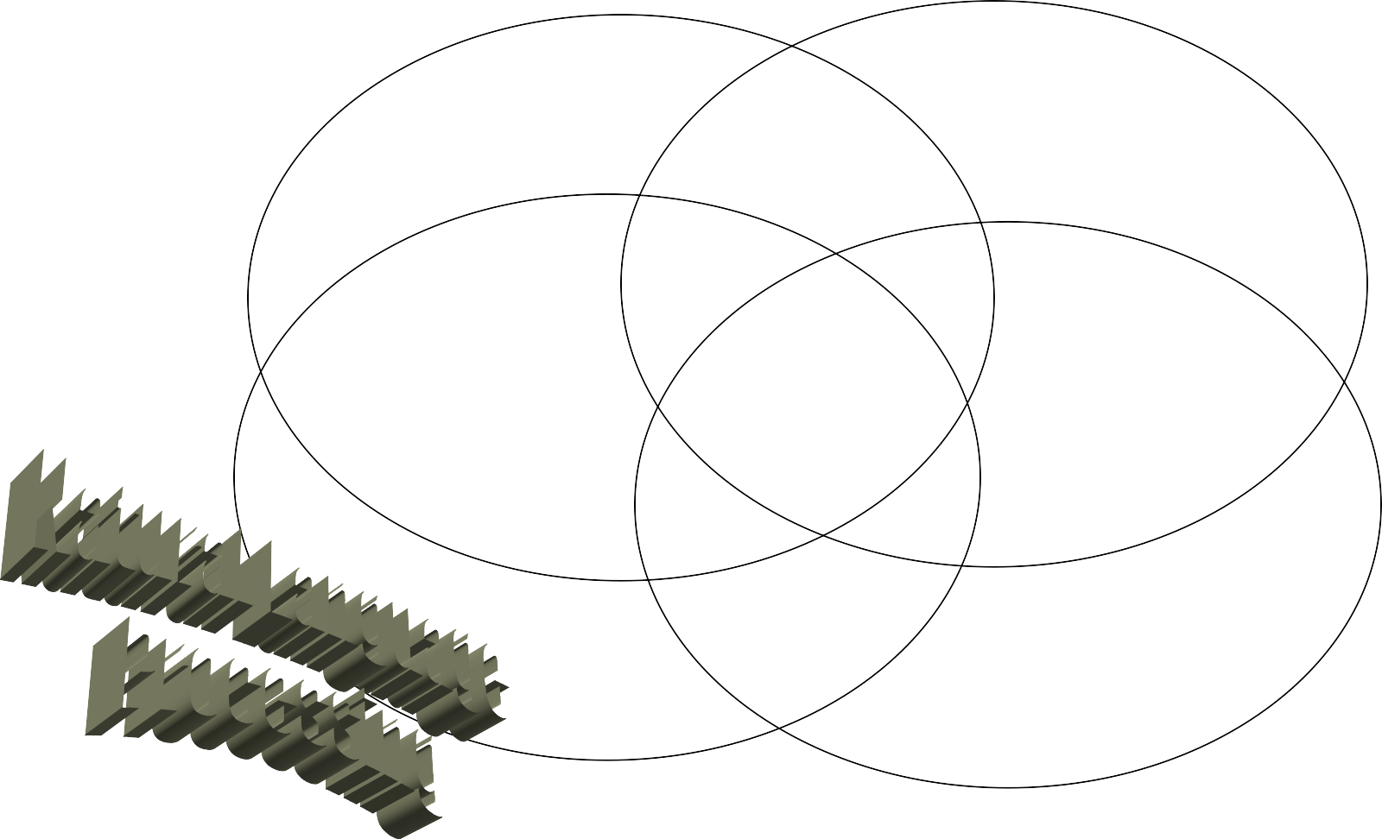













































Which areas are active in
Text Processing?
Knowledge Rep. & Reasoning
Search & DB
Computational Linguistics
Data Analysis
Department of Computer Engineering, VIIT , Pune-48

Slide 38
Introduction
●
The amount of information available on the Web has increased rapidly (Information-explosion era)
– World’s data doubles every 18 months
●
Users demand useful and reliable information from the Web in the shortest time possible
Obstacles to fulfilling this demand includes:
●
– Language barriers, diversified users.
Users may provide only vague specifications of the information they want
–
●
We must perform searching and extracting information from the Web texts using NLP technologies.
Department of Computer Engineering, VIIT , Pune-48

Slide 39
Text Mining
●
Data-mining: Extraction of interesting information (or patterns) from structured data.
80-90% of all data is held in various unstructured formats Useful information can be derived from this unstructured data Intelligence in text mining is based on NLP techniques
NLP can be used as a preprocessing technique to harvest data and get an initial understanding of the patterns that exist in the data
●
●
●
●
●
Text Mining = Statistical NLP (structured data) + Data mining (pattern discovery)
Department of Computer Engineering, VIIT , Pune-48

Slide 40
Text Mining Process
Text Preprocessing
Syntactic/Semantic text analysis Features Generation
Bag of words Features Selection
●
●
●
Simple counting Statistics
–
–
Data Mining
– Classification (Supervised) / Clustering (Unsupervised)
●
●
Analyzing results
Department of Computer Engineering, VIIT , Pune-48

Slide 41
Text Mining Process
Text Preprocessing
Part Of Speech (POS) tagging
Find the corresponding POS for each word.
Word sense disambiguation
Context based or proximity based
Parsing
Generates a parse tree for each sentence
●
Department of Computer Engineering, VIIT , Pune-48

Slide 42
Text Mining Process
Feature Generation
– Text document is represented by the words it contains (and their occurrences)
●
Order of words is not that important for certain applications (Bag of words)
Stemming: identifies a word by its root
●
–
Reduce dimensionality
Stop words: The common words unlikely to help text mining
–
Department of Computer Engineering, VIIT , Pune-48

Slide 43
Text Mining Process
Feature Selection
– Reduce dimensionality
●
Learners have difficulty addressing tasks with high dimensionality
Only interested in the information relevant to what is being analyzed
●
Irrelevant features
Not all features help
–
Department of Computer Engineering, VIIT , Pune-48

Slide 44
Text Mining Process
Supervised learning (classification)
– The training data is labeled indicating the class
– New data is classified based on the training set
– Correct classification: The known label of test sample is identical with the class result from the classification model.
Unsupervised learning (clustering)
– The class labels of training data are unknown
– Establish the existence of classes or clusters in the data – Good clustering method: high intra-cluster similarity and low intercluster similarity.
Department of Computer Engineering, VIIT , Pune-48

Slide 45
Text Mining Techniques
●
Descriptive: understanding underlying processes or behavior
Web Mining (Opinion extraction, Sentiment analysis) Clustering (Blogs, Patterns and trends)
–
–
●
Predictive: predict an unseen or unmeasured value
Classification (Spam detection) Information Retrieval (Seaching)
Pattern and trend forecasting, Knowledge Acquisition from query logs
Question answering
–
–
–
–
Department of Computer Engineering, VIIT , Pune-48

Slide 46
Challenges
●
Statistical NLP
POS Tagging Ambiguity
Tokenization \ Sentence Detection \ Parsing Context
Stemming
–
–
–
–
–
–
●
Data Mining
Massive amounts of data No training data available
–
–
Department of Computer Engineering, VIIT , Pune-48

Slide 47
Characteristics of Text Mining and challenges
1.sparse and high dimensional)
lack of structures
2.Bag-of-words
information analysis.
3. Semantical representations
cross-lingual linkages
4. String of words
joint mining of text data
47
Department of Computer Engineering, VIIT , Pune-48

Slide 48
The five fundamental steps involved in text mining are:
Gathering unstructured data from multiple data sources like plain text, web pages, pdf files, emails, and blogs, to name a few.
Detect and remove anomalies from data by conducting pre-processing and cleansing operations. Data cleansing allows you to extract and retain the valuable information hidden within the data and to help identify the roots of specific words.
For this, you get a number of text mining tools and text mining applications.
Convert all the relevant information extracted from unstructured data into structured formats.
Analyze the patterns within the data via the Management Information System (MIS).
Store all the valuable information into a secure database to drive trend analysis and enhance the decision-making process of the organization.
Department of Computer Engineering, VIIT , Pune-48

Slide 49
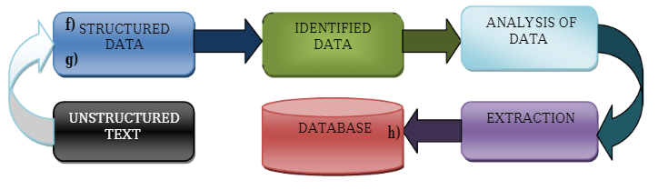
Text mining techniques can be understood at the processes that go into mining the text and discovering insights from it. These text mining techniques generally employ different text mining tools and applications for their execution.
Text mining techniques are continuously used in areas like search engines, customer relationship management systems, filter emails, product suggestion analysis, fraud detection, and social media analytics for opinion mining, feature extraction, sentiment, predictive, and trend analysis.
Department of Computer Engineering, VIIT , Pune-48

Slide 50
Text mining techniques
1. Information Extraction (IE)
Information extraction (IE) is a technique to automatically extract a piece of definite, structured information from unstructured or semi-structured data in the form of text using Natural Language Processing. It is used for the extraction of entities from the text, like names of persons, organization, location, and the relationship between entities, attributes, events, and relationships.
The extracted information is well-organized (structured) and stored in a database for further use. IE extracts specific attributes and entities from the document and establishes their relationship. The process used to check and evaluate the relevance of results is called ‘Precision and Recall.’
Department of Computer Engineering, VIIT , Pune-48

Slide 51
2. Information Retrieval (IR)
Information retrieval (IR) refers to finding and collecting relevant information from a variety of resources, usually documented in an unstructured format. It is a set of methods or approaches for methodically developing information needs of the users in the form of queries that are used to fetch a document from a collection of databases. IR helps to extract relevant and associated patterns according to a given set of words or phrases.
Department of Computer Engineering, VIIT , Pune-48

Slide 52
3. Text Categorization
This technique involves designating pre-decided categories to free-text documents that contain insights about the world. The purpose of text classification/text categorization is to increase the detection of information that can lead to a better decision. For example, news stories are typically organized by subject categories (topics) or geographical codes. Technical domains and subdomains often classify academic papers.
At the same time, patient reports in healthcare organizations are often indexed from multiple aspects, using taxonomies of disease categories, types of surgical procedures, insurance reimbursement codes, and so on. Another widespread application of text categorization is spam filtering, where email messages are classified into the two categories of spam and non-spam, respectively.
Department of Computer Engineering, VIIT , Pune-48

Slide 53
4. Document Clustering
This technique is used to find groups of documents with similar content. It makes use of descriptors and descriptor extraction that are essentially sets of words that describe the contents within the cluster. It is an unsupervised process responsible for classifying objects into groups called clusters, which consist of several documents. Dividing similar text into the same cluster forms the basis of this method.
Any labels associated with objects are obtained solely from the data. The advantage of this technique is that it ensures that no document is missed from search results since documents can emerge in numerous subtopics. For example, if clustering is performed on a collection of news articles, it can make sure that similar documents are kept closer to each other or lie in the same cluster.
Department of Computer Engineering, VIIT , Pune-48

Slide 54
5. Text Visualization
Text Visualization is a technique that represents large textual information into a visual map layout, which provides enhanced browsing capabilities along with simple searching. In text mining, visualization methods can improve and simplify the discovery of relevant information.
Text flags are used to show the document category to represent individual documents or groups of documents, and colors are used to show density. Visual text mining puts large textual sources in an appropriate visual hierarchy, which helps the user to interact with the document by scaling and zooming.
Department of Computer Engineering, VIIT , Pune-48

Slide 55
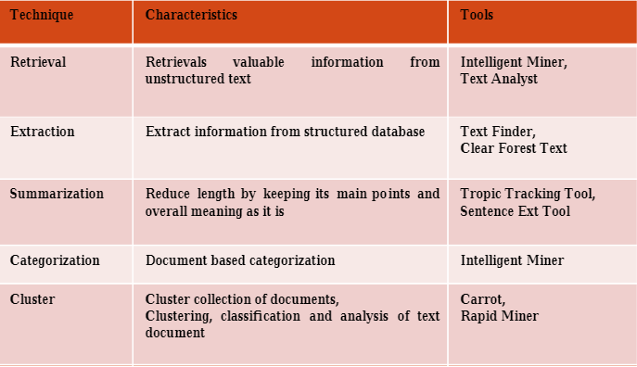
Department of Computer Engineering, VIIT , Pune-48

Slide 56
There are several text mining tasks performed while analyzing the text. They are:
Clustering
Factor analysis
Text classification
Text purification
Text summarization
Distributed storage and retrieval
Find similar documents
Find an association between terms
Find commonly occurring terms.
Department of Computer Engineering, VIIT , Pune-48

Slide 57
All text mining process follows these steps:
Collecting information: The textual data from various sources that are in a semi-structured or unstructured format is collected to perform text mining.
Conversion into structured data: Pre-processing involves cleaning the data that is collected.
Pattern identification: Various techniques used in text mining, which are discussed later, are then applied to extract meaningful information.
Pattern Analysis: The data obtained is analyzed to extract knowledge and meaning out of it.
Advanced analysis: Finally, the required knowledge is obtained and can then be used for further analysis
Department of Computer Engineering, VIIT , Pune-48

Slide 58
Text Mining Terminologies
Document is a sentence. For example, " Four score and seven years ago our fathers brought forth on this continent, a new nation, conceived in Liberty, and dedicated to the proposition that all men are created equal."
Tokens represent words. For example: "nation", "Liberty", "men".
Terms may represent single words or multiword units, such as “civil war”
Corpus is a collection of documents (database). For example, A corpus contains 16 documents (16 txt files).
Stopwords are basically a set of commonly used words which you want to exclude while analyzing text. Examples of stopwords - 'a', 'an', 'the', 'to', 'of', 'ABC Company' etc.
6 Document Term Matrix is a matrix consisting of documents in a row and terms in columns.
7. Sparse terms - Terms occurring only in very few documents (Sentences).
8. Tokenization - It is the process to divide unstructured data into tokens such as words, phrase, keywords etc.
Department of Computer Engineering, VIIT , Pune-48

Slide 59
9. Stemming - For example, "interesting", "interest" and "interested" are all stemmed to "interest". After that, we can stem to their original forms, so that the words would look "normal".
10. Polarity - Whether a document or sentence is positive, negative or neutral. This term is commonly used in sentiment analysis.
11. Bag-of-words - Each sentence (or document) is a bag of words ignoring grammar and even word order. The terms ' make India' and 'India make' have the same probability score.
12. Part of Speech Tagging - It involves tagging every word in the document and assigns part of speech - noun, verb, adjective, pronoun, single noun, plural noun, etc.
Department of Computer Engineering, VIIT , Pune-48

Slide 60
13. Term Frequency - Inverse Document Frequency (tf-idf) -
It measures how important a word is. It consists of two terms -
Term Frequency (tf)
Inverse Document Frequency (idf)
Term Frequency measures how frequently a word (term) occurs in a document.
TF(t) = (Number of times term t appears) / (Total number of terms).
Inverse Document Frequency measures how important a word is. If a word appears frequently in a document, then it should be important and we should give that word a high score. But if a word appears in too many other documents, it’s probably not a unique identifier, therefore we should assign a lower score to that word.
IDF(t) = log to base e(Total number of documents / Number of documents containing term t)
Department of Computer Engineering, VIIT , Pune-48

Slide 61
Term Frequency Inverse Document Frequency
tf-idf = tf × idf
Example : Suppose a word 'good' appears 373 times in total 6 documents which contains in total 122204 words (terms).
Term Frequency (TF) would be 0.00305 i.e. =373/122204.
But this word appears in only 1 document so IDF would be ln(6/1) = 1.791759.
Hence, tf-idf = TF * IDF = 0.0054.
Department of Computer Engineering, VIIT , Pune-48

Slide 62
Example:
Consider a document containing 100 words wherein the word cat appears 3 times.
Now, assume we have 10 million documents and the word cat appears in one thousand of these.
Department of Computer Engineering, VIIT , Pune-48

Slide 63
The term frequency (i.e., tf) for cat is then (3 / 100) = 0.03.
Then, the inverse document frequency (i.e., idf) is calculated as log(10,000,000 / 1,000) = 4.
Thus, the Tf-idf weight is the product of these quantities: 0.03 * 4 = 0.12.
Department of Computer Engineering, VIIT , Pune-48

Slide 64
Uses of TF-IDF
1. Building Stopwords
Terms having tf-idf value zero or close to zero can be used in stop-words list. These are all words that appear in all of the documents, so the idf term is zero.
2. Important Words
Sort TF-IDF values in descending order. The term which appear at top after sorting is the most important word.
3. Text Clustering
Calculate the tf-idf score for the collection of documents
Calculate pairwise distance matrix using cosine distance algorithm
Performs hierarchical clustering and visualize the clustering result with a dendrogram.
Department of Computer Engineering, VIIT , Pune-48

Slide 65
TF-IDF in python
scikit-learn library : It has a pre-built functionality under sklearn. Preprocessing
scikit-learn.org
Simple and efficient tools for predictive data analysis
Classification, regression, clustering, preprocessing, dimensionality reduction, model selection
Accessible to everybody, and reusable in various contexts
Built on NumPy, SciPy, and matplotlib
Open source, commercially usable - BSD license

Slide 66
import pandas as pd
from sklearn.feature_extraction.text import TfidfVectorizer
documentA = 'WE study in VIIT, India '
documentB = ‘I live in India and I am proud of my country'
bagOfWordsA = documentA.split(' ‘) #’WE’,’study’,’in’ , ……..
bagOfWordsB = documentB.split(' ')
uniqueWords = set(bagOfWordsA).union(set(bagOfWordsB)) #removes the duplicate words
#dictionary of words ,using corpus {live in we study viit india proud country of my }….
numOfWordsA = dict.fromkeys(uniqueWords, 0)
for word in bagOfWordsA:
numOfWordsA[word] += 1
numOfWordsB = dict.fromkeys(uniqueWords, 0)
for word in bagOfWordsB:
numOfWordsB[word] += 1
#list of stopwords to remove duplicates and stopwords
from nltk.corpus import stopwords
stopwords.words('english')

Slide 67
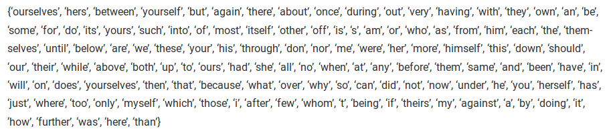

Slide 68
#calculate TF
def computeTF(wordDict, bagOfWords):
tfDict = {}
bagOfWordsCount = len(bagOfWords)
for word, count in wordDict.items():
tfDict[word] = count / float(bagOfWordsCount)
return tfDict
#calculate term frequency for each document
tfA = computeTF(numOfWordsA, bagOfWordsA)
tfB = computeTF(numOfWordsB, bagOfWordsB)

Slide 69
# calculate IDF Weight of words is calculated
def computeIDF(documents):
import math
N = len(documents)
idfDict = dict.fromkeys(documents[0].keys(), 0)
for document in documents:
for word, val in document.items():
if val > 0:
idfDict[word] += 1
for word, val in idfDict.items():
idfDict[word] = math.log(N / float(val))
return idfDict
#IDF for all document
idfs = computeIDF([numOfWordsA, numOfWordsB])

Slide 70
#Tf * IDF
def computeTFIDF(tfBagOfWords, idfs):
tfidf = {}
for word, val in tfBagOfWords.items():
tfidf[word] = val * idfs[word]
return tfidf
#Tf IDF score of all the document
tfidfA = computeTFIDF(tfA, idfs)
tfidfB = computeTFIDF(tfB, idfs)
df = pd.DataFrame([tfidfA, tfidfB])
#Tf IDF score using SKLEARN methods
vectorizer = TfidfVectorizer()
vectors = vectorizer.fit_transform([documentA, documentB])
feature_names = vectorizer.get_feature_names()
dense = vectors.todense()
denselist = dense.tolist()
df = pd.DataFrame(denselist, columns=feature_names)

Slide 71
corpus = [ ... 'This is the first document.', ...
'This document is the second document.', ...
'And this is the third one.', ...
'Is this the first document?’,
['and', 'document', 'first', 'is', 'one', 'second', 'the', 'third', 'this’]
[[0 1 1 1 0 0 1 0 1]
[0 2 0 1 0 1 1 0 1]
[1 0 0 1 1 0 1 1 1]
[0 1 1 1 0 0 1 0 1]]

Slide 72
['and this', 'document is', 'first document', 'is the', 'is this', 'second document', 'the first', 'the second', 'the third', 'third one', 'this document', 'this is', 'this the’]
[[0 0 1 1 0 0 1 0 0 0 0 1 0]
[0 1 0 1 0 1 0 1 0 0 1 0 0]
[1 0 0 1 0 0 0 0 1 1 0 1 0]
[0 0 1 0 1 0 1 0 0 0 0 0 1]]

Slide 73
Uses of TF-IDF
1. Building Stopwords
Terms having tf-idf value zero or close to zero can be used in stop-words list. These are all words that appear in all of the documents, so the idf term is zero.
2. Important Words
Sort TF-IDF values in descending order. The term which appear at top after sorting is the most important word.
3. Text Clustering
Calculate the tf-idf score for the collection of documents
Calculate pairwise distance matrix using cosine distance algorithm
Performs hierarchical clustering and visualize the clustering result with a dendrogram.
Department of Computer Engineering, VIIT , Pune-48

Slide 74
Summary
Tf-idf stands for term frequency-inverse document frequency, and the tf-idf weight is a weight often used in information retrieval and text mining.
This weight is a statistical measure used to evaluate how important a word is to a document in a collection or corpus.
The importance increases proportionally to the number of times a word appears in the document but is offset by the frequency of the word in the corpus.
Variations of the tf-idf weighting scheme are often used by search engines as a central tool in scoring and ranking a document's relevance given a user query.
Department of Computer Engineering, VIIT , Pune-48

Slide 75
Top 8 Text Mining Tools
MonkeyLearn | User-friendly text mining
Aylien | Simple API for text mining
IBM Watson | Powerful AI platform
Thematic | Text mining for customer feedback
Google Cloud NLP | Custom machine learning models
Amazon Comprehend | Pre-trained text mining models
MeaningCloud | Set of APIs for text analysis
Lexalytics | Text mining libraries
Department of Computer Engineering, VIIT , Pune-48

Slide 76
Web Mining
Web Mining is the process of Data Mining techniques to automatically discover and extract information from Web documents and services. The main purpose of web mining is discovering useful information from the World-Wide Web and its usage patterns.
Applications of Web Mining:
Web mining helps to improve the power of web search engine by classifying the web documents and identifying the web pages.
It is used for Web Searching e.g., Google, Yahoo etc
Web mining is used to predict user behavior.
Web mining is very useful for a particular Website and e-service
Department of Computer Engineering, VIIT , Pune-48

Slide 77
Web mining is an application of data mining techniques to find information patterns from the web data. Web mining helps to improve the power of web search engine by identifying the web pages and classifying the web documents. Web mining is very useful to e-commerce websites and e-services.
Web mining can be broadly divided into three different types of techniques of mining:
Web Content Mining
Web Structure Mining
Web Usage Mining.
Department of Computer Engineering, VIIT , Pune-48

Slide 78
There are three types of web mining:
1. Web Content Mining
Web content mining can be used for mining of useful data, information and knowledge from web page content.
Web structure mining helps to find useful knowledge or information pattern from the structure of hyperlinks.
Due to heterogeneity and absence of structure in web data, automated discovery of new knowledge pattern can be challenging to some extent.
Web content mining performs scanning and mining of the text, images and groups of web pages according to the content of the input (query), by displaying the list in search engines. For example: If an user wants to search for a particular book, then search engine provides the list of suggestions.
ProWebScraper (Web Content Mining Tool)
Department of Computer Engineering, VIIT , Pune-48

Slide 79
Web content mining is the application of extracting useful information from the content of the web documents. Web content consist of several types of data – text, image, audio, video etc.
Content data is the group of facts that a web page is designed. It can provide effective and interesting patterns about user needs.
Text documents are related to text mining, machine learning and natural language processing.
This mining is also known as text mining. This type of mining performs scanning and mining of the text, images and groups of web pages according to the content of the input.
Department of Computer Engineering, VIIT , Pune-48

Slide 80
2. Web Usage Mining
Web usage mining is used for mining the web log records (access information of web pages) and helps to discover the user access patterns of web pages.
Web server registers a web log entry for every web page.
Analysis of similarities in web log records can be useful to identify the potential customers for e-commerce companies.
Web usage mining is the application of identifying or discovering interesting usage patterns from large data sets. And these patterns enable you to understand the user behaviors or something like that.
In web usage mining, user access data on the web and collect data in form of logs. So, Web usage mining is also called log mining.
Department of Computer Engineering, VIIT , Pune-48

Slide 81
Some of the techniques to discover and analyze the web usage pattern are: i) Session and visitor analysis The analysis of preprocessed data can be performed in session analysis ,which includes the record of visitors, days, sessions etc. This information can be used to analyze the behavior of visitors.
Report is generated after this analysis, which contains the details of frequently visited web pages, common entry and exit.
ii) OLAP (Online Analytical Processing)OLAP performs Multidimensional analysis of complex data.
OLAP can be performed on different parts of log related data in a certain interval of time.
The OLAP tool can be used to derive the important business intelligence metrics.
Department of Computer Engineering, VIIT , Pune-48

Slide 82
3. Web Structure Mining
The web structure mining can be used to discover the link structure of hyperlink.
It is used to identify that the web pages are either linked by information or direct link connection.
The purpose of structure mining is to produce the structural summary of website and similar web pages.
Web structure mining is the application of discovering structure information from the web. The structure of the web graph consists of web pages as nodes, and hyperlinks as edges connecting related pages.
Department of Computer Engineering, VIIT , Pune-48

Slide 83
Structure mining basically shows the structured summary of a particular website. It identifies relationship between web pages linked by information or direct link connection.
Example: Web structure mining can be very useful to companies to determine the connection between two commercial websites.
Department of Computer Engineering, VIIT , Pune-48

Slide 84
Best Web Mining Tools
ProWebScraper (Web Content Mining Tool) ...
Google Analytics (Web Usage Mining Tool) ...
SimilarWeb (Web usage mining tool) ...
Majestic (Web structure mining tool) ...
Scrapy (Web content mining tool) ...
Bixo (Web structure mining tool) ...
Oracle data Mining (Web Usage Mining Tool) ...
Tableau ( Web Usage Mining tool )
Department of Computer Engineering, VIIT , Pune-48

Slide 85
Comparison Between Data mining and Web mining
POINTS | DATA MINING | WEB MINING
Definition | Data Mining is the process that attempts to discover pattern and hidden knowledge in large data sets in any system. | Web Mining is the process of data mining techniques to automatically discover and extract information from web documents.
Application | Data Mining is very useful for web page analysis. | Web Mining is very useful for a particular website and e-service.
Target Users | Data scientist and data engineers. | Data scientists along with data analysts.
Access | Data Mining is access data privately. | Web Mining is access data publicly.
Structure | In Data Mining get the information from explicit structure. | In Web Mining get the information from structured, unstructured and semi-structured web pages.
Department of Computer Engineering, VIIT , Pune-48

Slide 86
POINTS | DATA MINING | WEB MINING
Problem Type | Clustering, classification, regression, prediction, optimization and control. | Web content mining, Web structure mining.
Tools | It includes tools like machine learning algorithms. | Special tools for web mining are Scrapy, PageRank and Apache logs.
Skills | It includes approaches for data cleansing, machine learning algorithms. Statistics and probability. | It includes application level knowledge, data engineering with mathematical modules like statistics and probability.
Department of Computer Engineering, VIIT , Pune-48

Slide 87
Social Media Platform
Facebook
Whatsapp
Twitter
WeChat
Instagram
Twitter
Skype
Snapchat
Pinterest
LinkedIn
Telegram
Department of Computer Engineering, VIIT , Pune-48

Slide 88

Department of Computer Engineering, VIIT , Pune-48

Slide 89
Basic & Advanced Web Metrics Google Analytics
Web Analytics is a technique that you can employ to collect, measure, report, and analyze your website data. It is normally carried out to analyze the performance of a website and optimize its web usage.
Web Analytics is an essential technique for all those people who run their business online.
There is a wide range of web analytics tools that provide a simple report to examine your traffic trends, track user behavior, and website conversation.
The purpose of web analytics is to give you the knowledge from which you can make informed decisions about changing your online strategy—for the better.
So it’s important to include change, that is, changing your website or its marketing, as part of your metrics strategy.
Department of Computer Engineering, VIIT , Pune-48

Slide 90
If your website is an important part of your business strategy, then website measurement is also important to that strategy.
The magnitudes of each are strongly correlated— that is, the more valuable your website is to you, the greater the significance of your web measurement tools.
Such tools can be used to identify growth opportunities, measure efficiency improvements, and highlight things when they go wrong.
Department of Computer Engineering, VIIT , Pune-48

Slide 91
In order to do business effectively on the Web, you need to continually refine and optimize your online marketing strategy, site navigation, and page content (as well as how your offline marketing, press releases, and communications interact with your website).
A low-performing website will starve your return on investment (ROI ) and can damage your brand.
But you need to understand what is performing poorly—the targeting of your marketing campaigns, poor reviews of your products/services on the Web, or your website’s ability to convert once a visitor arrives.
Web analytics provides the tools for gathering this information and enables you to benchmark the effects.
Department of Computer Engineering, VIIT , Pune-48

Slide 92
In terms of benchmarks, it is important that any organization spend time in planning its key performance indicators (KPIs). KPI s provide a extraction of the excess of website visitor data available to you as clear, actionable information.
KPI s represent the key factors, specific to your organization, that measure success.
Google Analytics gives you the data from which KPI s are built and in some cases can provide a KPI directly. For example, saying “we had 10,000 visitors this week” is providing a piece of data.
A KPI based on this could be “our visitor numbers are increasing by 10 percent monthly”—that is an indicator saying things are looking good.
Most KPI s are ratios or percentages that enable you to take action, and the job of an analyst is to build these specific to your organization.
Department of Computer Engineering, VIIT , Pune-48

Slide 93
The ROI of Web Analytics
Google Analytics is a free data collection and reporting tool.
However, implementing, analyzing, interpreting, and making website changes all require a resource amount at
your end.
The amount of investment you make in web analytics, therefore, depends on how significant your website is to your overall business.
Department of Computer Engineering, VIIT , Pune-48

Slide 94
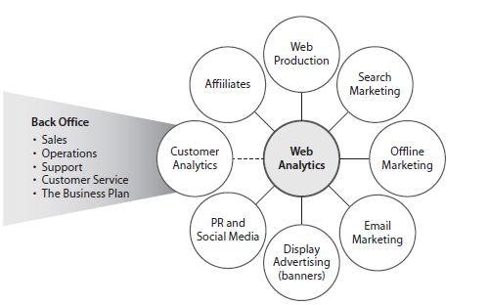
Where Web Analytics fit in an organization
Department of Computer Engineering, VIIT , Pune-48

Slide 95
Page tag solutions track visitors by using cookies. Cookies are small text messages that a web server transmits to a web browser so that it can keep track of the user’s activity on a specific website.
The visitor’s browser stores the cookie information on the local hard drive as name–value pairs.
Persistent cookies are those that are still available when the browser is closed and later reopened.
Conversely, session cookies last only for the duration of a visitor’s session (visit) to your site.
Department of Computer Engineering, VIIT , Pune-48

Slide 96
For web analytics, the main purpose of cookies is to identify users for later use—most often with an anonymous visitor ID .
Among many things, cookies can be used to determine how many first-time or repeat visitors a site has received, how many times a visitor returns each period, and how much time passes between visits.
Web analytics aside, web servers can also use cookie information to present personalized web pages.
A returning customer might see a different page than the one a first-time visitor would view, such as a “welcome back” message to give them a more individual experience or an auto-login for a returning subscriber.
Department of Computer Engineering, VIIT , Pune-48

Slide 97
Improving the Accuracy of Web Analytics Data
Clearly, web analytics is not 100 percent accurate, and the number of possible inaccuracies can appear overwhelming at first.
For example, web analytics can help you answer the following questions:
• Are visitor numbers increasing?
• By what rate are they increasing (or decreasing)?
Understanding how Google Analytics data collection works is a great way to recognize what you can achieve with web analytics reporting.
Department of Computer Engineering, VIIT , Pune-48

Slide 98
Website Analytics Tool
Analytics Tools offer an insight into the performance of your website, visitors’ behavior, and data flow. These tools are inexpensive and easy to use. Sometimes, they are even free.
Google Analytics
Google Analytics is a service that allows you to track blogs, social networks, websites, and provides customizable reports. It helps you to analyze your business data with ease.
Features:
It helps you to understand how people use your website.
Google Analytics enables you to organize your data in a better way.
This program supports desktop and mobile apps.
It provides a variety of reporting tools.
You can easily integrate with numerous other Google products.
Department of Computer Engineering, VIIT , Pune-48

Slide 99
Google Analytics is a freemium analytic tool that provides a detailed statistics of the web traffic. It is used by more than 60% of website owners.
Google analytics helps you to track and measure visitors, traffic sources, goals, conversion, and other metrics (as shown in the image-next slide).
Department of Computer Engineering, VIIT , Pune-48

Slide 100
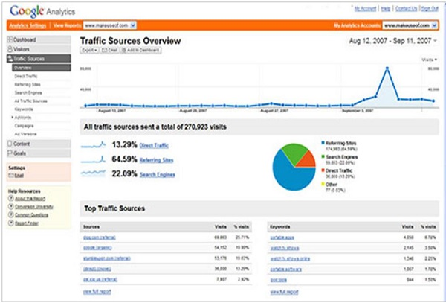
Department of Computer Engineering, VIIT , Pune-48

Slide 101
Getting the most from your Google Analytics
What is Google Analytics
• Service provided by Google for generating statistics about the visits to a web site
• Aimed at marketers
• Available since August 2006 to anyone free of charge
• Paid for premium version also available
• New features and functionality being added constantly
• Works by loading and executing tracking code on the visitor’s device then saving information gathered by this code on Google servers in a Google Analytics account
http://support.google.com/analytics/bin/answer.py?topic=1008008&ctx=topic&answer=1008065
Department of Computer Engineering, VIIT , Pune-48

Slide 102
It(Google Analytics) basically generates reports on −
Audience Analysis
Acquisition Analysis
Behavior Analysis
Conversion Analysis
Department of Computer Engineering, VIIT , Pune-48

Slide 103
Audience Analysis
As the name suggests, audience analysis gives you an overview of the audience who visit your site along with their session history, page-views, bounce rate(Bounce rate is single-page sessions divided by all sessions, or the percentage of all sessions on your site in which users viewed only a single page and triggered only a single request to the Analytics server.), etc. You can trace the new as well as the returning users along with their geographical locations.
You can track −
The age and gender of your audience under Demographics.
The affinity reach and market segmentation under Interests.
Language and location under Geo.
New and returning visitors, their frequency, and engagement under Behavior.
Department of Computer Engineering, VIIT , Pune-48

Slide 104
Browsers, Operating systems, and network of your audience in Technology.
Mobile device info under Mobile.
Custom variable report under Custom. This report shows the activity by custom modules that you created to capture the selections.
Benchmarking channels, locations, and devices under Benchmarking. Benchmarking allows you to compare your metrics with other related industries. So, you can plot what you need to acquire in order to overtake the market.
Flow of user activity under Users flow to see the path they took on your website.
Department of Computer Engineering, VIIT , Pune-48

Slide 105
Acquisition Analysis
Acquisition means ‘to acquire.’ Acquisition analysis is carried out to find out the sources from where your web traffic originates. Using acquisition analysis, you can −
Capture traffic from all channels, particular source/medium, and from referrals.
Trace traffic from AdWords (paid search).
See traffic from search engines. Here, you can see Queries, triggered landing pages, and geographical summary.
Department of Computer Engineering, VIIT , Pune-48

Slide 106
Track social media traffic. It helps you to identify networks where your users are engaged. You can see referrals from where your traffic originates.
You can also have a view of your hub activity, bookmarking sites follow-up, etc.
In the same tab, you can have a look at your authorizations in details. It helps you measure the impact of social media on your website.
See which plug-ins gave you traffic.
Have a look at all the campaigns you built throughout your website with detailed statistics of paid/organic keywords and the cost incurred on it.
Department of Computer Engineering, VIIT , Pune-48

Slide 107
Behavior Analysis
Behavior analysis monitors users’ activities on a website. You can find behavioral data under the following four segments −
Site Content − It shows how many pages were viewed. You can see the detailed interaction of data across all pages or in segments like content drill-down, landing pages, and exit pages. Content drill-down is breaking up of data into sub-folders. Landing page is the page where the user lands, and exit page is where the user exits your site. You can measure the behavioral flow in terms of content.
Site Speed − Here, you can capture page load time, execution speed, and performance data. You can see how quickly the browser can parse through the page. Further, you can measure page timings, user timings, and get speed suggestion. It helps you to know where you are lagging.
Department of Computer Engineering, VIIT , Pune-48

Slide 108
Site Search − It gives you a full picture of how the users search across your site, what they normally look for, and how they arrive at a particular landing page. You can analyze what they search for before landing on your website.
Events − Events are visitors’ actions with content, which can be traced independently. Example − downloads, sign up, log-in, etc.
Department of Computer Engineering, VIIT , Pune-48

Slide 109
Conversion Analysis
Conversion is a goal completion or a transaction by a user on your website. For example, download, checkout, buy, etc. To track conversions in analytics, you need to define a goal and set a URL that is traceable.
Goals − Metrics that measure a profitable activity that you want the user to complete. You can set them to track the actions. Each time a goal is achieved, a conversion is added to your data. You can observe goal completion, value, reverse path, and goal flow.
Ecommerce − You can set ecommerce tracking to know what the users buy from your website. It helps you to find product performance, sale performance, transactions, and purchase time. Based on these data, you can analyze what can be beneficial and what can incur you loss.
Department of Computer Engineering, VIIT , Pune-48

Slide 110
Multi-channel funnels − Multi-channel funnels or MCF reports the source of conversion; what roles the website plays, referrals’ role in that conversion; and what all slabs did when users pass through landing page to conversion.
For example, a user searched for a query on Google search page, he visited the website, but did not convert. Later on, he directly typed your website name and made a purchase. All these activities can be traced on MCF.
Department of Computer Engineering, VIIT , Pune-48

Slide 111
Attribution − Attribution modeling credits sales and conversions to touch points in conversion tracking. It lets you decide what platforms or strategy or module is the best for your business.
Suppose a person visited your website through AdWords ad(Google AdWords is one of the services advertisers use for online promotion of their content, brand, website, etc through certain defined keywords to achieve traffic or leads. Google Ads, AKA Google AdWords, is Google's advertising system in which advertisers bid on certain keywords in order for their clickable ads to appear in Google's search results. Since advertisers have to pay for these clicks, this is how Google makes money from search.) and made no purchase. A month later, he visits via a social platform and again does not buy. Third time, he visited directly and converted.
Here, the last interaction model will credit direct for the conversion, whereas first interaction model will assign credit to paid medium. This way, you can analyze what module should be credited for a conversion.
Department of Computer Engineering, VIIT , Pune-48

Slide 112
Google Analytics Guide

Slide 113
Key Features and Capabilities of Google Analytics
Standard Features
The tool includes the “must have” basic metrics you need in order to get an initial understanding of your website performance.
However, these are not basic reports. You can quickly extract rich detail with a couple of mouse clicks, for example, cross-referencing e-commerce revenue by referral source or search engine keyword.
Full Campaign Reporting—Not Just AdWords
Google Analytics enables you to track and compare all your visitors—from nonpaid organic search, paid ads (pay per click, banners), referrals, email newsletters, affiliate campaigns, links from within digital collateral such as PDF files, and any other search engine or medium that forwards a visitor to your website.
Department of Computer Engineering, VIIT , Pune-48

Slide 114
E-commerce Reporting
You can trace transactions to campaigns and keywords, get loyalty and latency metrics, and identify your revenue sources. Similarly, you can drill down to this information on a per-product or per-category basis.
Advertising ROI—Integration with AdWords and AdSense
If you manage a pay-per-click campaign, you know what a chore tagging your landing page URL s can be—each one has to have at least one campaign variable appended to differentiate visitors who click through from nonpaid search results.
In addition, you will want to import your AdWords cost and impression data. As you might expect,Google has simplified the integration process as much as possible, in fact to just two check boxes.
Department of Computer Engineering, VIIT , Pune-48

Slide 115
As a result, all your AdWords landing page URL s are tagged, and cost data is imported automatically each day.
Similarly for publishers who display AdWords on their site, that is, use AdSense, the integration is straightforward.
The result is reports showing you which content drives the most revenue alongside the import of AdSense page impressions and the
number of AdSense ads clicked on.
Department of Computer Engineering, VIIT , Pune-48

Slide 116
Goal Conversions (Key Performance Indicators)
A goal conversion is a key pageview that brings you closer to your otherwise anonymous visitors. Think of these as your more valuable pageviews.
An obvious goal conversion is an e-commerce purchase-confirmation page.
However, other nontransactional goals exist, for example, completing a registration or feedback form, downloading a file, watching a movie (how-to guides, product demonstrations), commenting on blogs, submitting surveys, or clicking an outbound link.
In addition to defining pageviews as goal conversions, you can also set thresholds. For example, time on site greater than 30 seconds or pages per visit greater than 2.5.
In total, you can define up to 20 separate goals, which can be grouped into four categories (termed goal types).
Department of Computer Engineering, VIIT , Pune-48

Slide 117
Funnel Visualization
Funnels are set paths visitors take before achieving a goal conversion. An obvious funnel is an e-commerce checkout process. However, just as for goal conversions, other
nontransactional funnels exist—for example, a multiform subscription process where each completed form is a funnel step.
It is also possible to define funnel steps as the completion of individual form fields, such as name or product selection, so that partial form completion can be visualized.
By visualizing the visitor path (the funnel), you can discover which pages result in lost conversions and where your would-be customers go. Each funnel can contain up to 10 steps.
Department of Computer Engineering, VIIT , Pune-48

Slide 118
Customized Dashboards
The dashboard is the first section you see when viewing your reports. The dashboard is a selection of abridged reports from the main sections of Google Analytics.
Here you place and organize your key data selections for an at-a-glance comparison. Upto 12 reports can be added, changed, and reordered within the dashboard at any time.
Dashboards are on a per-user basis; that is, different user logins have different dashboards.
Site Overlay Report
Site overlay is a graphical way of looking at the popularity of links on your pages. You view your key metrics overlaid on your web page links. It’s an easy-to-view snapshot of which links are working for you.
Department of Computer Engineering, VIIT , Pune-48

Slide 119
Map Overlay Reports
Similar to site overlay, map overlay is a graphical way of presenting data that reflects where visitors are connecting from around the world when viewing your website.
Based on IP address location databases, they show your key metrics overlaid on a world, regional, or country map, depending on your zoom level.
This provides a clear representation of which parts of the world visitors are connecting from, down to city level.
This report sets the industry standard for visualizing where visitors come from to your site.
Department of Computer Engineering, VIIT , Pune-48

Slide 120
Cross Segmenting Drill-Down
Cross segmenting is the terminology used for cross-referencing, or correlating, one set of data against another.
An example of cross segmentation might be displaying the geolocation report for California and then cross segmenting to display which search engines these visitors are coming from.
As another example, suppose you want to determine, for U.K. visitors, the most frequently used keywords to find your site.
That would be a cross-reference of U.K. visitors against keywords. Similarly, for new visitors, what landing pages they arrived at—a cross-reference of visitor type against landing page.
There are many other examples, and cross segmentation is available within nearly every Google Analytics report. It’s a powerful feature that allows you to drill into table data to isolate particular visit types.
Department of Computer Engineering, VIIT , Pune-48

Slide 121
Data Export and Scheduling
Report data can be manually exported in a variety of formats, including CS V (best for Excel), TS V, PDF (best for printing), or the open-source XML (best for importing into another system).
You can also schedule any report to be emailed to you and your colleagues automatically, for up to 10 email addresses.
For example, you may want to email your e-commerce manager the list of top-selling products each week, your marketing manager the list of campaign performance, or your web designer the list of error pages generated.
Department of Computer Engineering, VIIT , Pune-48

Slide 122
Performance and evaluation measures
Department of Computer Engineering, VIIT , Pune-48

Slide 123
True Positives (TP) - These are the correctly predicted positive values which means that the value of actual class is yes and the value of predicted class is also yes. E.g. if actual class value indicates that this passenger survived and predicted class tells you the same thing.
True Negatives (TN) - These are the correctly predicted negative values which means that the value of actual class is no and value of predicted class is also no. E.g. if actual class says this passenger did not survive and predicted class tells you the same thing.
False positives and false negatives, these values occur when your actual class contradicts with the predicted class.

Slide 124
False Positives (FP) – When actual class is no and predicted class is yes. E.g. if actual class says this passenger did not survive but predicted class tells you that this passenger will survive.
False Negatives (FN) – When actual class is yes but predicted class in no. E.g. if actual class value indicates that this passenger survived and predicted class tells you that passenger will die.

Slide 125
Once you understand these four parameters then we can calculate Accuracy, Precision, Recall and F1 score.
Accuracy - Accuracy is the performance measure and it is simply a ratio of correctly predicted observation to the total observations.
Accuracy is a great measure but only when you have symmetric datasets where values of false positive and false negatives are almost same.
Accuracy = TP+TN/(TP+FP+FN+TN)

Slide 126
Is accuracy the best measure?
Accuracy may not be a good measure if the dataset is not balanced (both negative and positive classes have different number of data instances).
Consider the following scenario: There are 90 people who are healthy (negative) and 10 people who have some disease (positive).
Now let’s say our machine learning model perfectly classified the 90 people as healthy but it also classified the unhealthy people as healthy. What will happen in this scenario?
For that consider the confusion matrix and find out the accuracy.
In this example, TN = 90, FP = 0, FN = 10 and TP = 0. The confusion matrix is as follows.

Slide 127
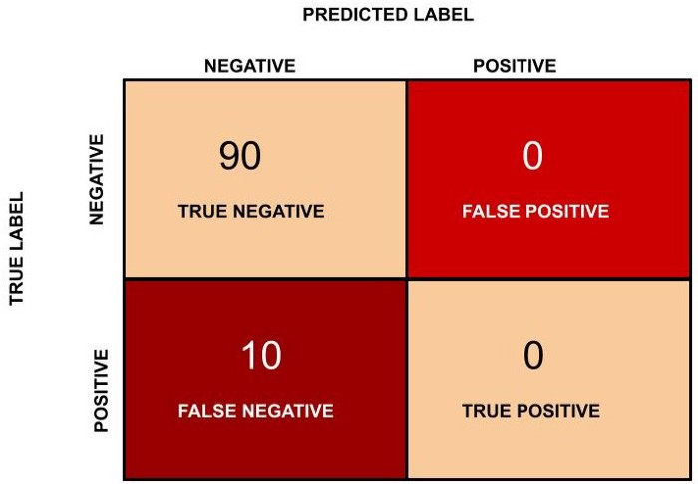
Accuracy in this case will be (90 + 0)/(100) = 0.9 and in percentage the accuracy is 90 %.

Slide 128
The accuracy, in this case, is 90 % but this model is very poor because all the 10 people who are unhealthy are classified as healthy.
From this example it is clear that accuracy is not a good metric when the data set is unbalanced. Using accuracy in such scenarios can result in misleading interpretation of results.
Hence consider another metric called as F-measure.

Slide 129


Precision - Precision is the ratio of correctly predicted positive observations to the total predicted positive observations. The question that this metric answer is of all passengers that labeled as survived, how many actually survived? High precision relates to the low false positive rate.
Precision = TP/TP+FP
Precision alone is not very helpful because it ignores the negative class. The metric is usually paired with Recall metric. Recall is also called sensitivity or true positive rate.
Recall (Sensitivity) - Recall is the ratio of correctly predicted positive observations to the all observations in actual class - yes. The question recall answers is: Of all the passengers that truly survived, how many did we label?
Recall = TP/TP+FN

Slide 130
F1 score - F1 Score is the weighted average of Precision and Recall. Therefore, this score takes both false positives and false negatives into account. Naturally it is not as easy to understand as accuracy, but F1 is usually more useful than accuracy, especially if you have an uneven class distribution.
Accuracy works best if false positives and false negatives have similar cost. If the cost of false positives and false negatives are very different, it’s better to look at both Precision and Recall.
F1 Score = 2*(Recall * Precision) / (Recall + Precision)
F1 Score becomes 1 only when precision and recall are both 1. F1 score becomes high only when both precision and recall are high. F1 score is the harmonic mean of precision and recall and is a better measure than accuracy.

Slide 131
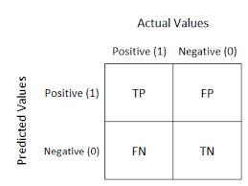
Confusion Matrix

Slide 132
Consider a dataset with a 1:100 minority to majority ratio, with 100 minority examples and 10,000 majority class examples.
A model makes predictions and predicts 120 examples as belonging to the minority class, 90 of which are correct, and 30 of which are incorrect.
The precision for this model is calculated as:
Precision = TruePositives / (TruePositives + FalsePositives)
Precision = 90 / (90 + 30)
Precision = 90 / 120
Precision = 0.75
The result is a precision of 0.75, which is a reasonable value but not outstanding.

Slide 133
Other Important Terms using a Confusion matrix
Positive Predictive Value(PVV): This is very much near to precision. One significant difference between the two-term is that PVV considers occurrence. In the situation where the classes are perfectly balanced, the positive predictive value is the same as precision.
Null Error Rate: This term is used to define how many times your prediction would be wrong if you can predict the majority class. You can consider it as a baseline metric to compare your classifier.
F Score: F1 score is a weighted average score of the true positive (recall) and precision.
Roc Curve(Receiver operating characteristic curve): Roc curve shows the true positive rates against the false positive rate at various cut points. It also demonstrates a trade-off between sensitivity (recall and specificity or the true negative rate).

Slide 134
Campaign analytics
Understand whether the campaign was able to successfully deliver the intended message or not. You can also test the effectiveness of your Call to actions.
Marketers are faced with the burden of bringing in good and high-quality leads for the business. This could include both short term as well as long term goals. But how do they achieve these goals? By running various campaigns, of course.
This also means that they have to measure if their efforts are worth it. And that is where campaign analytics come in. It affects a marketer’s decision on where to invest marketing funds and what strategy he needs to adapt for the future. It is also great at boosting the effectiveness and quality of the business. And, instead of putting all their eggs in the wrong basket, marketers will know where to invest and why.

Slide 135
What are campaign analytics?
Campaign analytics is the data pertaining to the results of marketing campaigns. Marketing may be running promotional campaigns via email or even through social media. In order to measure the ROI of these marketing efforts, it is necessary to analyze and test various parameters.
Different campaigns created by businesses
You may think that creating a business campaign is as difficult as moving a mountain. But, in reality, it is not. Though it may seem complicated and time-consuming, a well planned out marketing campaign can significantly boost your revenue.

Slide 136
Usually, marketing campaigns are designed to target and reach a very specific set of audiences. You need to identify the goal of the campaign before setting one.
The more precise your goals, the more success you can enjoy. There are various types of campaigns that marketers set.
3 Types of campaigns are:
Social media
Email campaigns
Paid campaigns

Slide 137
Social media campaign
Social media is a great way to reach your audience. As of 2018, there are 3.196 active social media users (Source). This is a huge market right there. And, marketers are fast adopting this as a platform to raise brand awareness. To do this right, you have to first perform a social media audit.

Slide 138
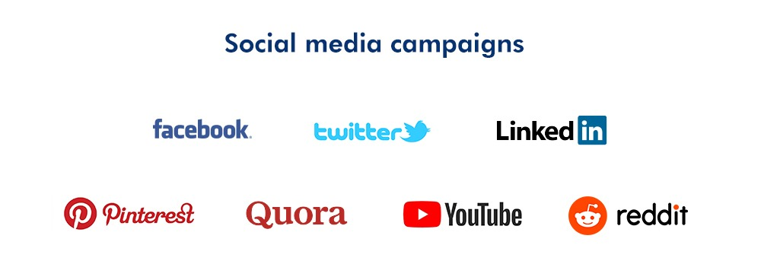
A social media audit lets you know how popular your social presence is. Once you know this, then you can focus on what you need to do to build it or expand your audience further. You can then start building a social media marketing strategy. How do you build this?

Slide 139
Know your audience: Identify your target users. Know where they are most likely to spend their time and be on it. Is your ideal audience, at home mothers between the ages of 30-50? Chances are they use a lot of Pinterest.
Understand the mode of communication: You know where your audience is. Now figure out what to tell them and how. Do you think a very detailed image would do the trick? Or maybe a nice long article? Or perhaps, a video is the way to go.
Find out when to send the message: Now, you need to know when your audience is mostly active. Imagine sending messaged at 3 am to an audience that largely falls asleep at 11 pm.
Curate your content: Don’t just send random messages on a craze. Do your research and send them a mix of various content. Test and keep testing, to know what works best.

Slide 140
Email campaigns
Email is perhaps the most effective method in which you can get your marketing message across. The best part is that it is highly measurable, easy to create.
Similar to social media campaigns, email campaigns also need to be well planned.
Make your message clear and concise and plan your campaigns in advance.
But, how do you know if your campaigns are working?

Slide 141
Metrics to Measure:
The open rate: This shows the number of emails that were opened out of the total number of emails that were sent for the campaign. The most beneficial open statistic is the unique open because it entails the number of people that have opened the sent emails more than once.
Delivery and bounce rate: This refers to how many emails were delivered and how many bounced, that is, undelivered.
Click through rate: Click through rate refers to or shows who is interested enough to read your emails and also to click on the website to gain more information. When the click-through rates of your company increases then it leads to higher conversion rates.
Unsubscribed rates: Unsubscribed rates are the result received from how many opt out of receiving emails from you. It is important because it allows businesses to quickly know something is wrong. They can then take measures to find out why, and how to fix it.
Conversion rates: Marketers or businesses use this data to measure if the important message was related to the target audience.

Slide 142
Paid Campaigns
Paid search campaigns can give your business a great boost and gives you an advantage over your competition. With paid campaigns, businesses can advertise over different platforms and search engines like Google. Search engine users type relevant keywords, and then your business advertisement comes up.

Slide 143
Although paid ad platforms do charge a fee, there are more benefits to be gained. Most PPC(Pay Per Click) platforms allow you to selectively choose an audience. This allows you to ensure that only relevant people see your ad.
Here are some benefits to paid campaigns.
It produces a faster result without a lot of time and effort spent.
It helps in bringing more customers and leads to your website.
It provides better leads.
It boosts brand awareness.

Slide 144
Metrics to Measure:
Device: You can measure the performance of your paid campaigns by the device you run it on. Some ads perform better on desktops, while some work better on mobile devices. This actually helps you determine which one to focus on
Click through rates: This is calculated by dividing the number of clicks by the total number of impressions made multiplied by 100%. A higher CTR means, more people are clicking on your ad and that your ad is relevant to your audience.
Conversion rates: This is the math that tells you how well your business is performing. To calculate- the number of conversions divided by the total number of clicks multiplied by 100.

Slide 145
Bounce rates: You can measure your bounce rate using your Google Analytics tool. A bounce is when a user clicks an advert but does not do anything. This will tell you that maybe you need to make your ad a little more interesting.
Lead Quality: This is an underrated but very important metric. The quality of the lead tells you if it’s worth running the ad or not. If your ad gives you poor leads who are not interested, it’s all a waste.

Slide 146
References
https://www.geeksforgeeks.org/what-is-unstructured-data/
https://dzone.com/articles/top-10-steps-for-analyzing-unstructured-data-for-s
https://tdwi.org/articles/2018/09/25/data-all-3-use-cases-unstructured-data.aspx
https://www.upgrad.com/blog/what-is-text-mining-techniques-and-applications/
https://roboticsbiz.com/text-mining-methods-and-techniques-the-beginners-guide/
https://www.geeksforgeeks.org/web-mining/
https://www.tutorialride.com/data-mining/web-mining.htm
https://monkeylearn.com/blog/text-analysis-tools/
https://www.tutorialspoint.com/web_analytics/google_analytics.htm
https://blog.exsilio.com/all/accuracy-precision-recall-f1-score-interpretation-of-performance-measures/#:~:text=Recall%20(Sensitivity)%20%2D%20Recall%20is,observations%20in%20actual%20class%20%2D%20yes.&text=F1%20score%20%2D%20F1%20Score%20is,and%20false%20negatives%20into%20account.
https://medium.com/analytics-vidhya/confusion-matrix-accuracy-precision-recall-f1-score-ade299cf63cd
https://www.leadsquared.com/campaign-analytics/#:~:text=Campaign%20analytics%20is%20the%20data,or%20even%20through%20social%20media.
Department of Computer Engineering, VIIT , Pune-48

Slide 147
UNSTRUCTURED DATA MINING AND ITS APPLICATIONS 1 Jagruti Jangal Wagh, 2 Jidnyasa Dharmik Gondane, 3 Ashvini Tulshiram Dukare. 1,2Student, Department of Computer Engineering, Cummins College of Engineering for Women Pune, Savitribai Phule Pune University
Department of Computer Engineering, VIIT , Pune-48

Slide 148
148
Thank You
Department of Computer Engineering, VIIT , Pune-48

